Slide 1

Superstore Sales
Dashboard
WEEK 4
DATA VISUALIZATION
& DASHBOARDING
AnalystLab Africa — Batch B Internship Program
June 2025 — Analyst: Adekoya Kikelomo Akorede
Tool: Superstore Dataset (Kaggle) • 2014–2017

Slide 2




Dataset Overview
9,994
793
49
4
Total Records
Unique Customers
US States covered
Years of data
Orders 2014–2017
Across 4 US regions
Continental + Hawaii
2014, 2015, 2016, 2017
Key columns in dataset
Order ID, Order Date, Ship Date
Ship Mode, Customer ID, Customer Name
Segment, Country, City, State
Region, Product ID, Category
Sub-Category, Product Name
Sales, Quantity, Discount, Profit

Slide 3

Business Problem
What the business needs to know:
Which region drives the most profit?
Which product categories underperform?
What seasonal sales patterns exist?
Which customer segments are most valuable?
Where are discounts hurting margins?
Dashboard Goal
Enable decision-makers to monitor KPIs, identify profit drivers, and spot underperforming products — at a glance, with interactive filters.

Slide 4





KPIs Defined
Key Performance Indicators tracked in the dashboard
Total Revenue
Total Profit
Profit Margin
$2.30M
$286K
12.5%
Sum of all sales 2014–2017
Net profit across all orders
Profit ÷ Revenue
Total Orders
Top Region
Loss Sub-Cat
9,994
West
Tables
Unique order count
$108K profit — highest
-$17K — biggest loss-maker

Slide 5
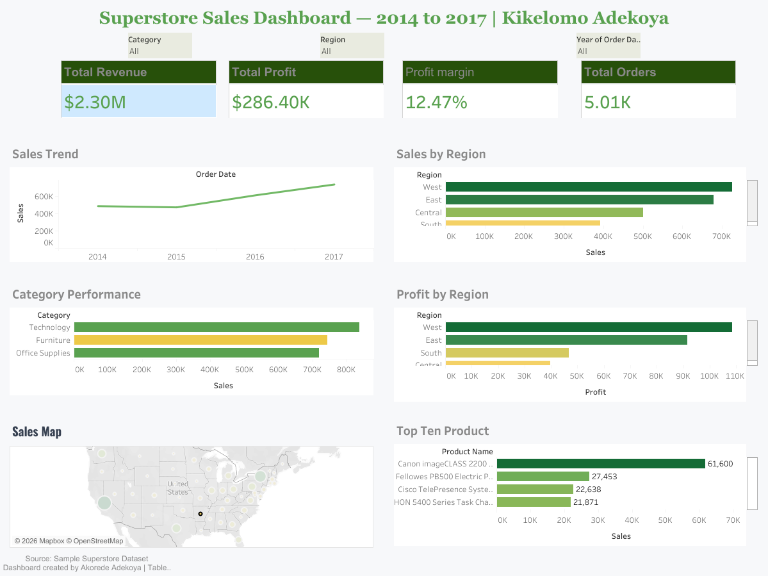
Interactive Dashboard

Slide 6
Key Insights
What the data tells us
West dominates profit
Tech leads revenue
The West region contributes $108K profit — more than any other. Invest in scaling West operations.
Technology ($836K) is the top-selling category, but Office Supplies shows stronger profit margin.
Q4 seasonal spike
Tables are loss-makers
November–December consistently shows 2× the monthly average — ideal for promotional campaigns.
Tables, Bookcases, and Supplies sub-categories all report negative margins. Review pricing strategy.

Slide 7
Recommendations
Actionable next steps for stakeholders
01
Expand in the West & East
Allocate more marketing budget to the two most profitable regions. Run targeted campaigns to grow customer share.
02
Rethink furniture pricing
Tables and Bookcases are consistently loss-making. Increase prices, reduce discounts, or consider discontinuation.
03
Capitalise on Q4 demand
Build up inventory 6 weeks before November. Launch holiday bundles in Technology and Office Supplies.
04
Reduce discount leakage
Deep discounts erode margins by up to 60% in some sub-categories. Cap discounts at 20% and monitor impact.

Slide 8
Challenges & Learnings
Challenges faced
What I learned
Handling missing / null values in Order Date
Choosing the right chart type for each metric
Designing a clean layout without clutter
Setting up slicers for multi-level filtering
Making the dashboard accessible on smaller screens
Data cleaning is 60% of the analyst's work
KPIs must be defined before building visuals
Colour consistency improves readability
Storytelling matters more than chart count
Interactive filters add significant business value

Slide 9
Project Complete
Superstore Sales Dashboard — Week 4 Deliverable
Dashboard built with Power BI / Tableau • Dataset: Kaggle Superstore
#AnalystLabAfrica • @AnalystLabAfrica on LinkedIn
Thank you!

